Slide 1
Fab4Friday
Every teacher in our school teaches every child. Fab4Fridays allow this to happen. Each teacher has a specialist area. They share their passion for the subject with us all.
Miss Atkin- Cookery
Mrs Burton- RE
Mr Spelman- ICT
Miss Parker- Art

Slide 2
Each teacher plans, using the National Curriculum as a guide, to deliver their subject specialism to all ages. This helps all children and adults to foster strong relationships as well as ensuring a progression in skills. The enthusiasm of our teachers is infectious! Our work is collated in portfolios. We have our own individual one for ICT and Art but a shared Cookbook of Evidence for Cookery and a Class Bible where the best examples of our RE work are collated and displayed in every classroom.
Fab4Friday

Slide 3
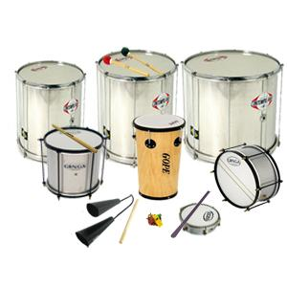
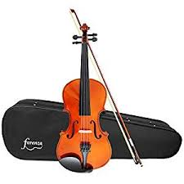
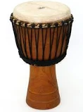
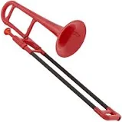
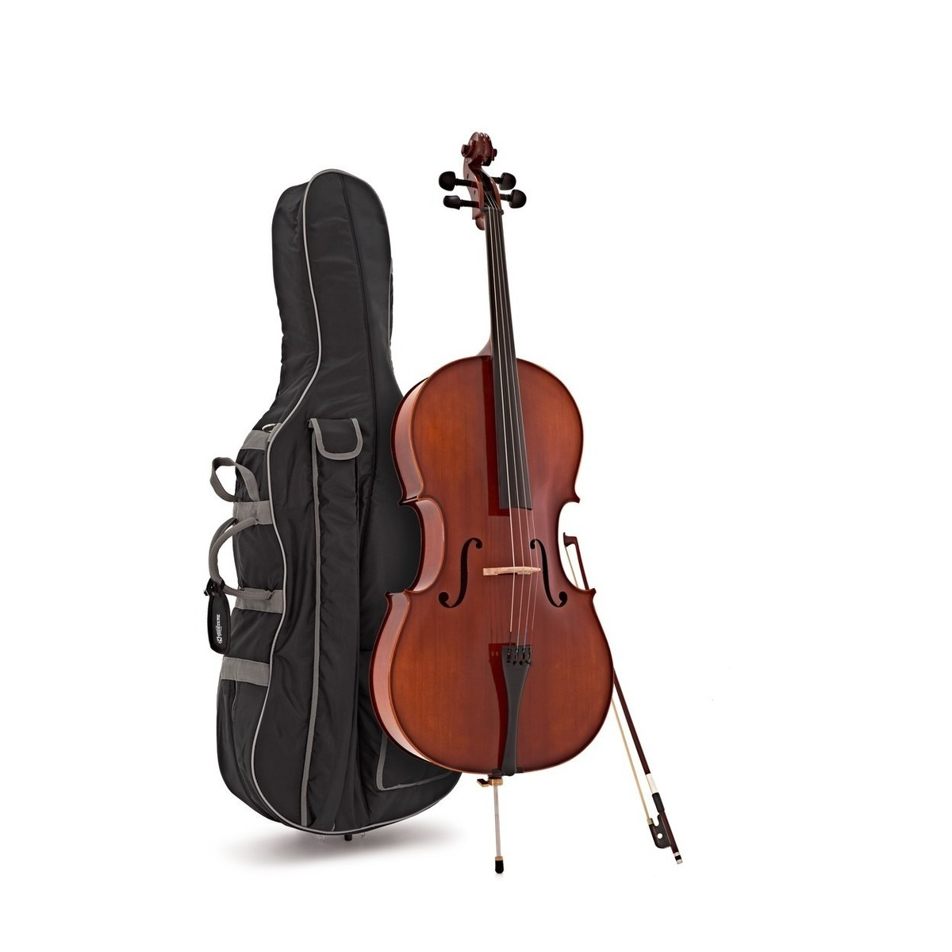
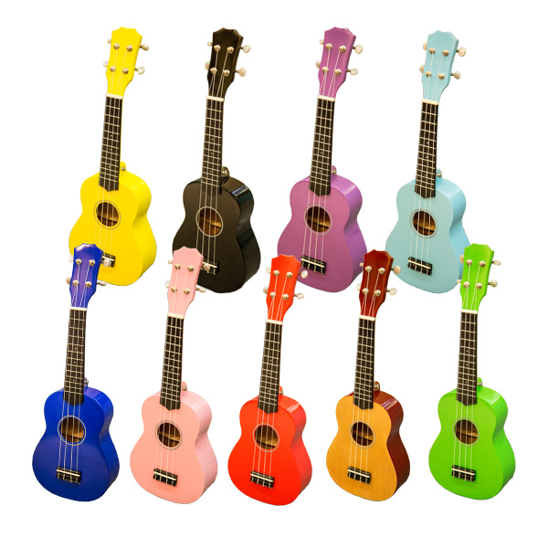
All children in Key Stage 2 also get taught by specialists from the Lincolnshire Music Service on a weekly basis.

